Slide 1

AeroSense: AI-Powered Respiratory Health Companion
A Strategic Response to Digital Health Market Failures
DeMarcus CrumpITAI-2372 - Artificial Intelligence Applications

Slide 2

The Digital Health Crisis
Hardware Failures
Engagement Crisis
Teva's Digihaler discontinued, Propeller Health ceased direct-to-consumer operations
Manual-entry apps suffer from "data fatigue" and high abandonment rates
Fragmented Solutions
Current tools are reactive, not proactive, failing to address patient needs

Slide 3
Market Opportunity
The digital health market for chronic respiratory diseases reveals a landscape defined by significant market failure. Current solutions are fragmented, fundamentally reactive, and fail to address the profound, unmet needs of patients.
70%
90%
82%
Trigger-Related
Technique Errors
Lack Validation
Asthma exacerbations linked to environmental triggers
Patients make critical inhaler technique mistakes
Exacerbation prediction studies without external validation

Slide 4
Critical Jobs-to-Be-Done
01
02
Trigger Identification Dilemma
Inhaler Technique Crisis
Patients struggle to correlate symptoms with environmental factors like pollen, air quality, and weather patterns
Critical medication delivery failures compromise treatment efficacy for nearly 90% of patients
03
04
Invisible Data Gap
Psychological Toll
Crucial nocturnal symptoms go unrecorded due to recall bias and sleep-time occurrence
Constant monitoring creates cognitive load, contributing to anxiety and depression

Slide 5
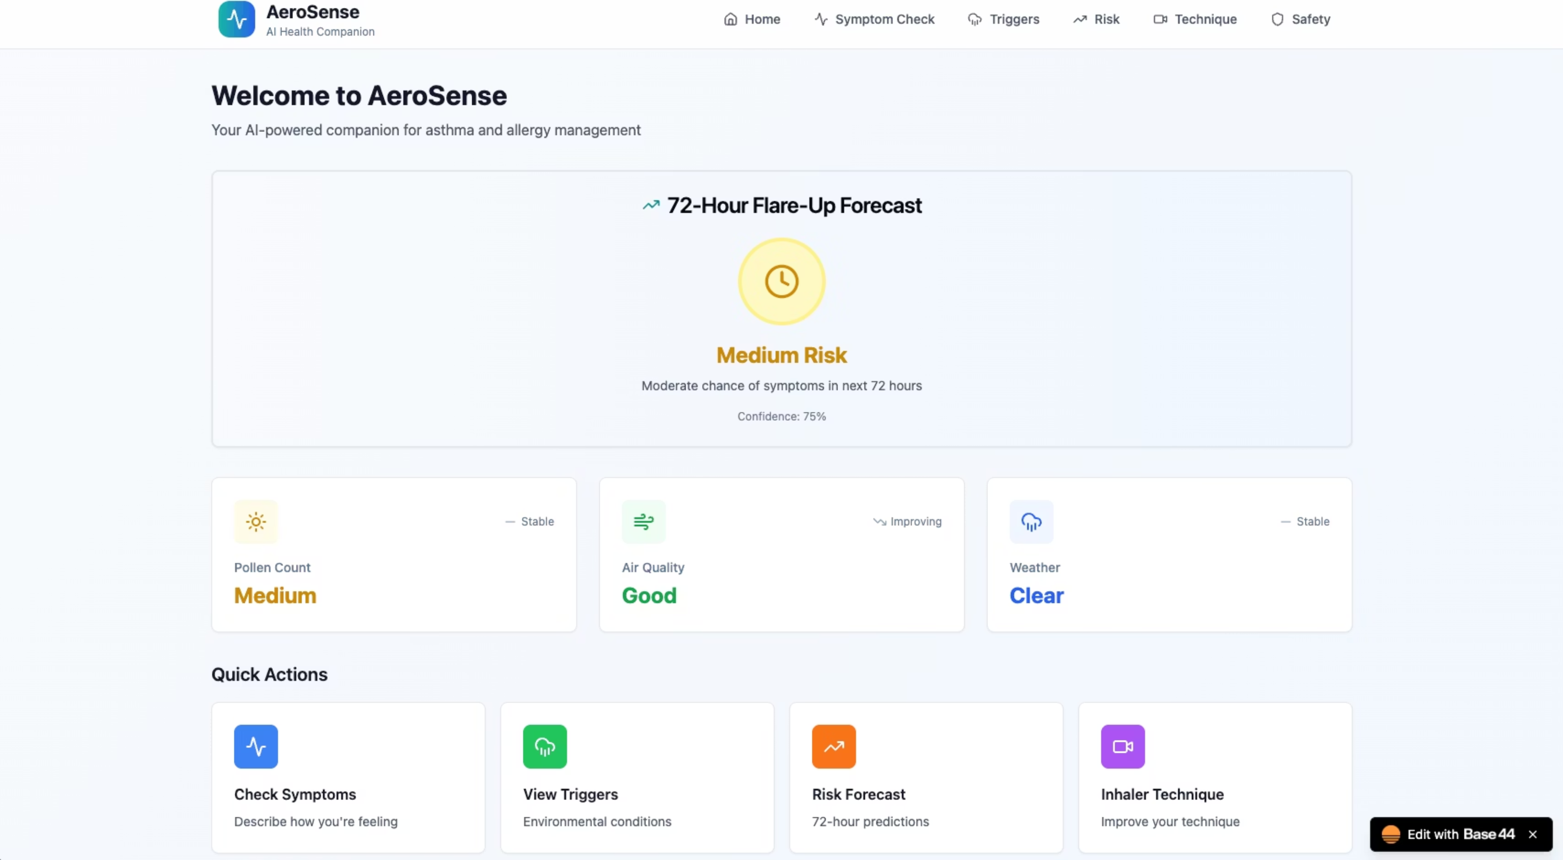
The Solution
AeroSense is an AI-powered educational companion that moves beyond reactive tracking to offer proactive, personalized insights. Each core feature is engineered to solve a specific, research-validated problem.

Slide 6
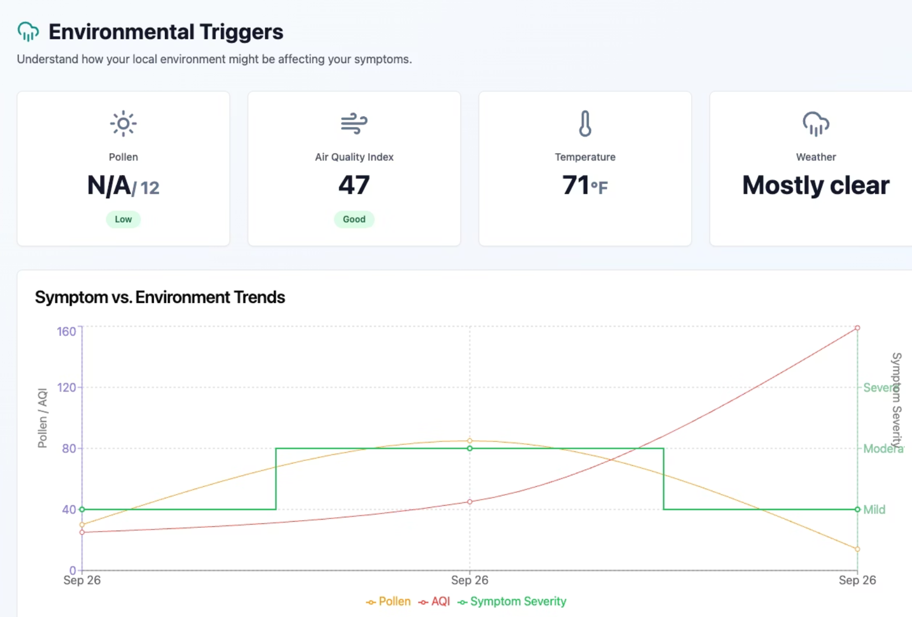
Environmental Intelligence Dashboard
Problem Addressed
The Trigger Identification Dilemma - patients can't connect environmental factors to their symptoms.
Solution
AeroSense integrates real-time API data for pollen, AQI, and weather, allowing users to visually correlate external data with logged symptoms. This transforms one-dimensional data into personalized, two-dimensional insights.

Slide 7

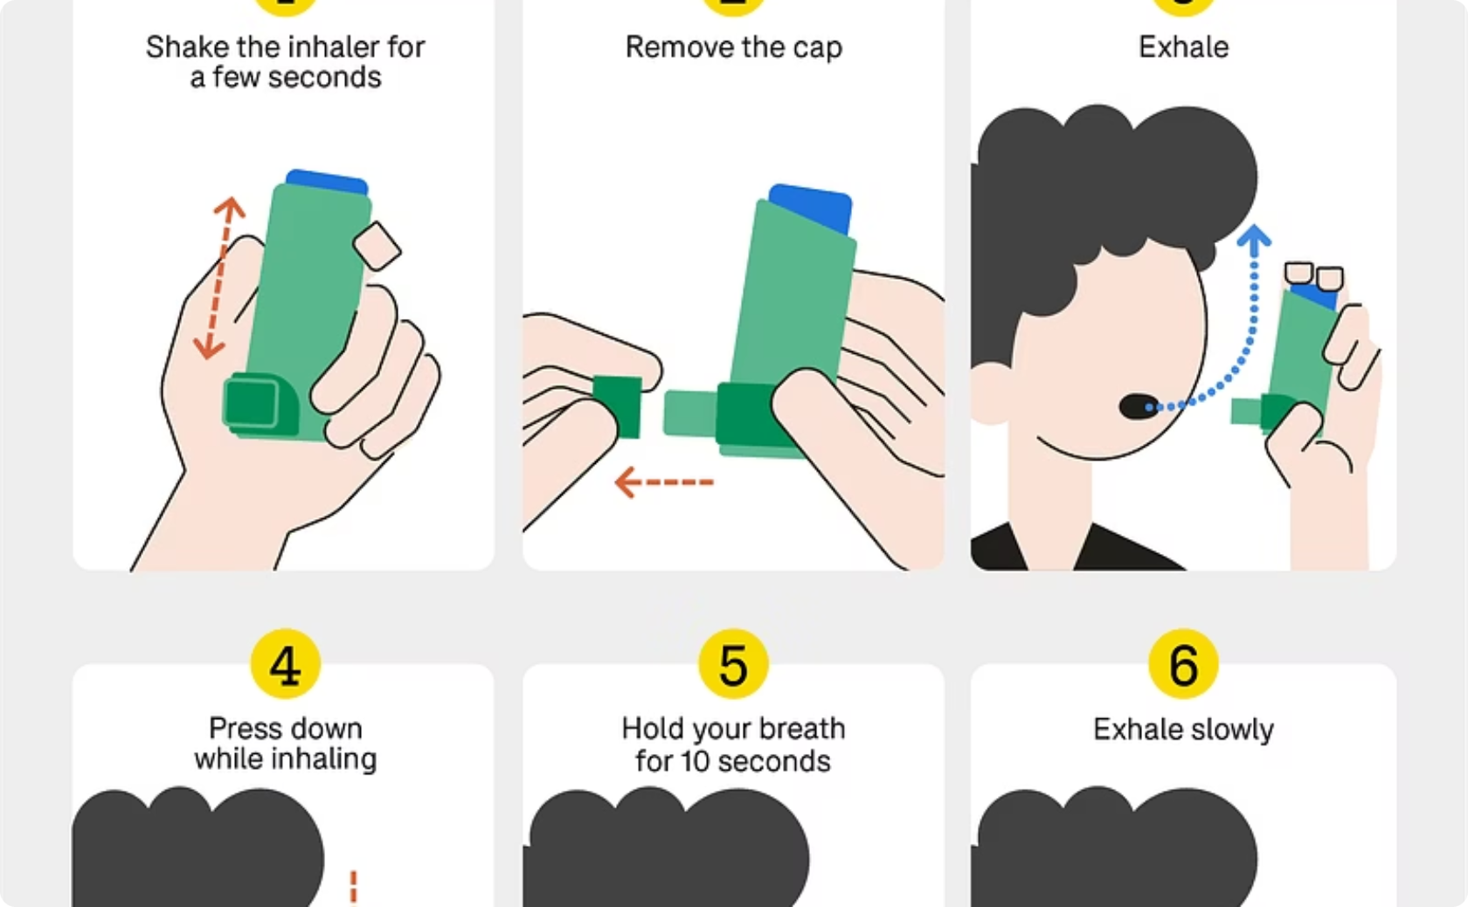
Smart Inhaler Technique Analyzer
Computer Vision Analysis
Educational Feedback
Uses webcam to analyze inhaler technique in real-time, providing immediate feedback
Democratizes access to training typically only available during clinical visits
Addresses the critical 90% error rate in inhaler technique that severely compromises treatment efficacy.

Slide 8



AI Symptom Interpreter & Risk Forecasting
Natural Language Input
Pattern Analysis
72-Hour Forecast
NLP interprets symptoms from natural language, lowering data entry barriers
AI analyzes symptom patterns over time using advanced machine learning
Creates risk predictions enabling proactive rather than reactive care

Slide 9



Strategic Positioning
1
Market Leadership
2
Intelligent Health Education
3
Software-Only, Data-Rich, Insight-Driven
AeroSense creates and leads a new market category, avoiding the fatal flaws of hardware-centric predecessors through pure software innovation.

Slide 10

Ethical AI Framework
Educational Tool
Confidence Scores
Healthcare Guidance
Explicitly positioned as educational, not a medical device, with clear disclaimers
All information presented with transparency about AI model limitations
Consistently directs users to consult qualified healthcare professionals
Recognizing that 82% of exacerbation prediction studies lack external validation, AeroSense operates with strict ethical guardrails.

Slide 11




Technical Architecture
Real-Time APIs
Computer Vision
Integration with environmental data sources for pollen, air quality, and weather information
Webcam-based inhaler technique analysis using advanced image processing
Natural Language Processing
Predictive Analytics
Symptom interpretation from user descriptions in natural language
Machine learning models for 72-hour risk forecasting and pattern recognition

Slide 12


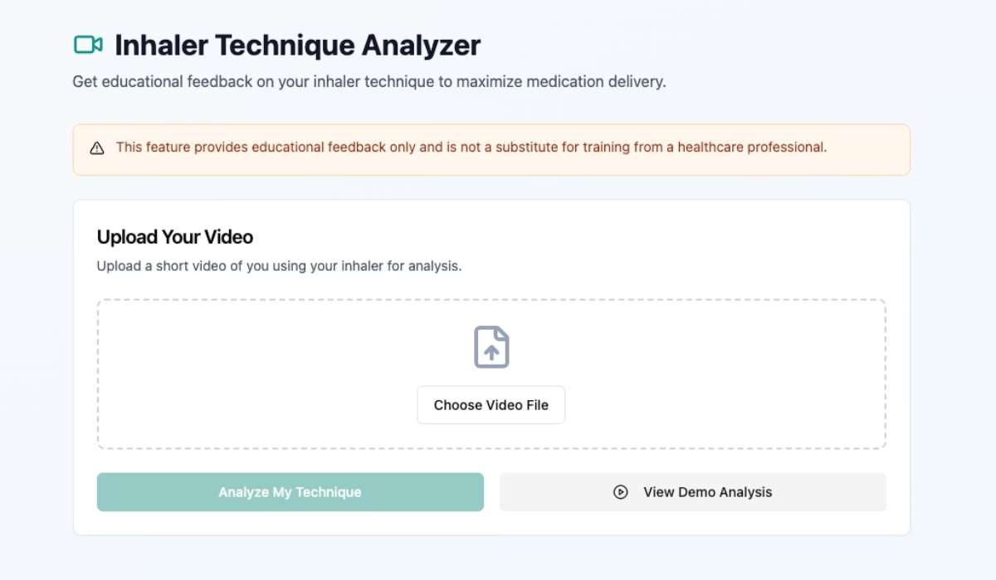
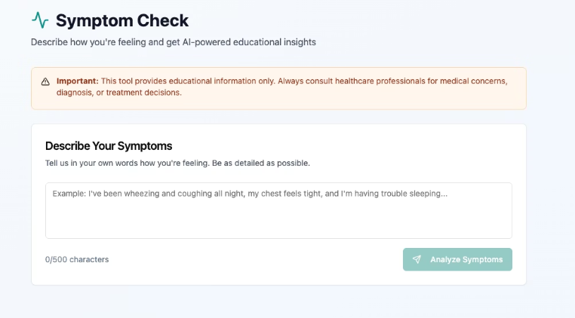
Live Application
Experience AeroSense
The fully functional application demonstrates all core features including environmental intelligence, inhaler technique analysis, and AI-powered symptom interpretation.

Slide 13



Development Repository
The complete source code and development history showcase the technical implementation of AeroSense's AI-powered features.
Open Source
Technical Documentation
Full codebase available for review and collaboration
Comprehensive implementation details and architecture decisions

Slide 14
Research Methodology
Market Analysis
1
Systematic review of digital health market failures and discontinued products
2
User Research
Analysis of 373 app store reviews and 2,180 Reddit posts from asthma community
Clinical Literature
3
Review of peer-reviewed studies on asthma management and AI applications
4
Solution Design
Evidence-based feature development addressing identified pain points

Slide 15

Key Research Findings
App Reviews
Reddit Posts
Clinical Studies
Market Reports
Comprehensive research across multiple sources revealed consistent patterns of user frustration and unmet needs in current respiratory health applications.

Slide 16

Personal Mission
Born from Experience
This project began with a personal mission, born from a lifelong journey with asthma and allergies, to understand how technology could genuinely help patients.
Beyond Academic Exercise
More than coursework, this assignment has reshaped my perspective on AI's role in healthcare - not to replace clinicians, but to empower patients as partners in their own care.

Slide 17










Impact on Healthcare AI
Care Partnership
Patient Education
Enabling patients as true partners in their healthcare journey
AI's immediate opportunity in personalized health education
Data-Driven Insights
Transforming personal health data into actionable understanding
Patient Empowerment
Providing control and confidence in disease management
Proactive Care
Moving from reactive treatment to predictive prevention

Slide 18

Future Vision
Platform Expansion
Immediate Impact
Extend intelligent health education model to other chronic conditions
Deploy AeroSense to help current respiratory patients gain control and confidence
Market Transformation
Healthcare Integration
Establish new category of AI-powered health education tools
Partner with healthcare providers to enhance patient-clinician collaboration

Slide 19

Key References
App Store Review Analysis (2025): Systematic review of 373 reviews across top 10 asthma/allergy apps
Budiarto, A., et al. (2023): Machine learning-based models for predicting asthma exacerbations. JMIR AI, 2(1)
FDA (2025): Artificial Intelligence/Machine Learning-Enabled Device Software Functions: Lifecycle Management
MarketResearch.com (2024): Smart Inhalers Market Global Forecast to 2032
Patient Forums Analysis (2025): Reddit r/Asthma community analysis (2,180 posts, 2022-2025)

Slide 20

Thank You
AeroSense represents more than a technical solution - it's a blueprint for the future of AI in healthcare, where technology empowers patients with the personalized education and data-driven understanding needed to become true partners in their own care.
DeMarcus Crump
Ready to carry this vision forward

